Slide 1
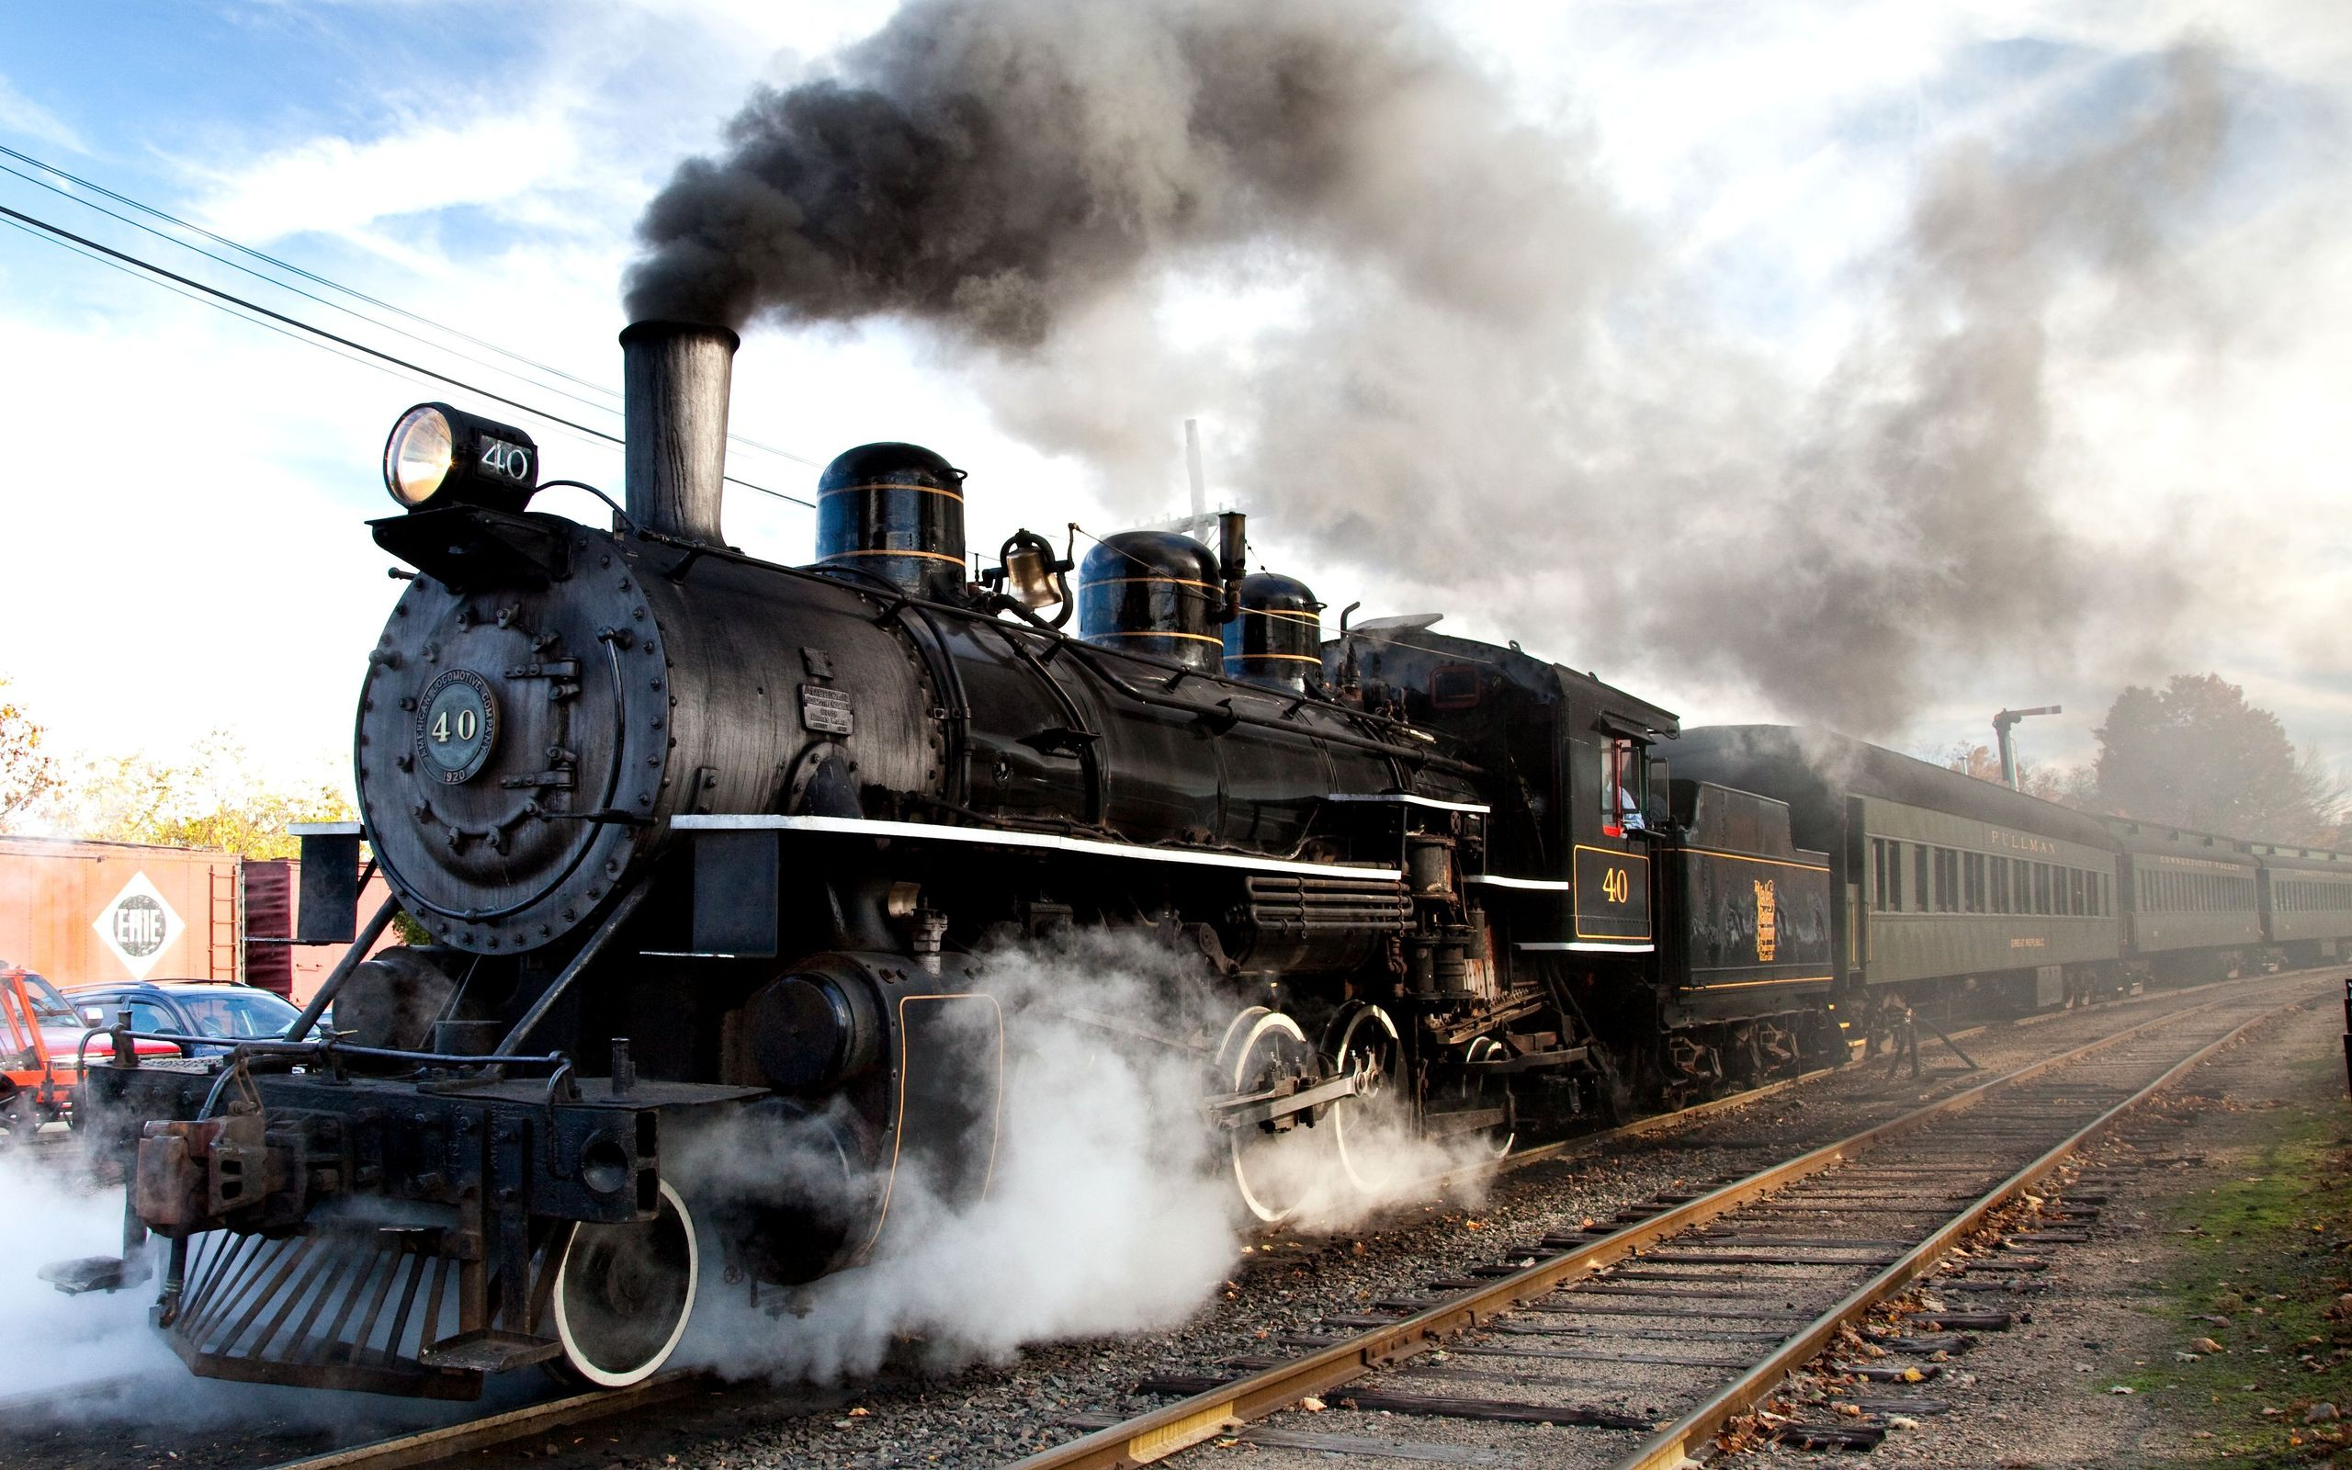
BookmyTrain
-We take care for your comfort

Slide 2

Functions of DBMS:
More specifically, a DBMS provides the following functions:
Concurrency: concurrent access (meaning 'at the same time') to the same database by multiple users
Security: security rules to determine access rights of users
Backup and recovery: processes to back-up the data regularly and recover data if a problem occurs
Integrity: database structure and rules improve the integrity of the data
Data descriptions: a data dictionary provides a description of the data

Slide 3
Uses of DBMS in Online Ticket Reservation
It helps to manage the data of the passengers in a large scale .
It helps allot the seats correctly in a easy way.
It can

Slide 4
Use of Data Validation:
Data validation is the process of ensuring that user input is clean, correct, and useful.
Typical validation tasks are:
has the user filled in all required fields?
has the user entered a valid date?
has the user entered text in a numeric field?
Most often, the purpose of data validation is to ensure correct user input.
Validation can be defined by many different methods, and deployed in many different ways.
Server side validation is performed by a web server, after input has been sent to the server.
Client side validation is performed by a web browser, before input is sent to a web server.

Slide 5
CLICK HERE TO BOOK

Slide 6
OUR TEAM MEMBERS ARE:
Dharun
Manesh Karun
Vinaya krishna
Priyadharshan
Nandhika
Priyanka

Slide 7


